Slide 1
Research on Emerging Technologies: What have we learned and how does it impact the interest of practice, standard setters, and regulators?
Helen Brown-Liburd

Slide 2
Outline
Standards: Where are we?
What we have learned from the existing literature examining digital transformation to gain an understanding of:
the set of underlying factors
types of innovation in use by accounting firms,
client willingness to pay for audit innovation, and
the behavioral and cognitive implications
how these factors impact audit quality.
Develop future lines of inquiry related to the impact of emerging technologies

Slide 3
PCAOB
Exploring
the new technology-based tools being used in audits and the impact on the audit of new technologies used by issuers,
changes to firms' methodologies,
academic research, and
the activities of others, including auditing standard setters
Established the Data and Technology Task Force in 2017 to assist the staff in obtaining insights into the use of data analytics and certain emerging technologies (2017 – 2022).
Perception that PCAOB auditing standards do not preclude audit firms’ use of technology-based tools during an audit.
Acknowledge current standards do not explicitly encourage the use of such tools, indicate when their use may or may not be appropriate, or highlight related risks or possible pitfalls associated with their use
In 2022, the Board also approved the formation of the Technology Innovation Alliance Working Group to advise the Board on the impact of emerging technologies and provide recommendations for PCAOB oversight.

Slide 4
The International Auditing and Assurance Standards Board (IAASB)
Established a Data Analytics Working Group (DAWG) to:
Explore emerging developments in the effective and appropriate use of technology, including data analytics, to enhance audit quality; and
understand how the use of technology and more specifically, data analytics, is able to enhance audit quality (thus retaining the audit’s place in the financial reporting chain and enhancing the reliability of the audit in an increasingly technology driven environment).
understand how auditors are innovating to meet emerging public interest expectations.
Explore how to most effectively can respond to these emerging developments via new or revised International Standards on Auditing or non-authoritative guidance (including Staff publications) and in what timeframe.
dialogue with auditors of all sizes, regulators and audit oversight bodies, preparers, investors, those charged with governance, other relevant stakeholders in the external reporting supply chain and national auditing standard setters to further understand relevant issues and to leverage the work that has been done by others.
In September 2016 the Data Analytics Working Group released a Working Group Paper, Exploring the Growing Use of Technology in the Audit, with a Focus on Data Analytics.

Slide 5
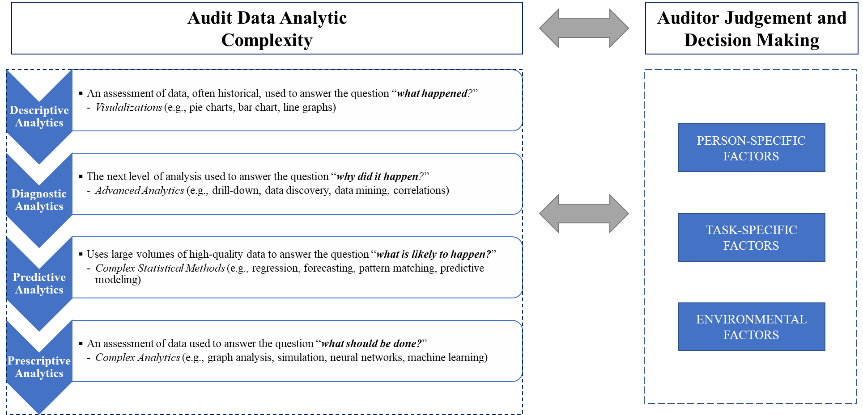
Framework
Notes:
Used to categorize existing literature

Slide 6
A Few Takeaways
Regional factors play a significant role in the adoption of technology by audit firms (e.g., government influence, competition of audit firms within the region, regional regulations, and advancement of technology).
Stakeholder views (e.g., peer reviewers, regulators) influence auditors' willingness to adopt the technology.
Client expectations and preference for data access positively affect the auditor's actual use of technologies
Leveraging technology to evaluate nonfinancial information narrows the expectations gap because auditors and other stakeholders support the use of technology.
Adoption of RPA and drone technologies in the firms suggest a material increase in audit efficiency and effectiveness postadoption
Environmental Factors
Notes:
FOR EXAMPLE, THE REGION'S AVAILABILITY OF THE NECESSARY TALENT TO DEVELOP, DEPLOY AND USE THESE EMERGING TECHNOLOGIES PLAYS A SIGNIFICANT ROLE IN THE WILLINGNESS TO ADOPT. THE TYPES OF CLIENT (E.G., ISSUER VS. NONISSUER, CLIENT SIZE ALSO MATTER. IF THERE IS NO BUSINESS NEED, IT IS UNLIKELY THAT A FIRM WILL BE WILLING TO INVEST. FOR EXAMPLE, I TEACH AN ADA COURSE AT A UNIVERSITY IN ICELAND, THE SIZE OF THE FIRMS THERE AND THE CLIENTS RESULT IN A LOWER LEVEL OF ADA.
INSPECTION RISK IS NOT SURPRISING. HOWEVER, IF THE PERCEPTION IS THAT INTERNAL REVIEWERS ARE NOT POSITIVE TOWARDS ADAS, THAN AUDITORS ARE LESS WILLING TO USE ADAS
THE SOPHISTICATION OF THE CLIENT (E.G., THEIR USE AND KNOWLEDGE OF ADA, ALLOWING DATA ACCESS; INSIGHT) DIRECTLY INFLUENCE HOW THE AUDITOR CAN DEPLOY THE EMERGING TECHNOLOGY DURING THE AUDIT.
THE POSSIBILITY OF AN EXPECTATION GAP WIDENS WHEN AUDITORS ADVERTISE THEIR USE OF EMERGING TECHNOLOGIES TO TEST FULL POPULATIONS OF TRANSACTIONS. THE EXPECTATIONS OF THE CLIENT'S INVESTORS MAY SHIFT FROM REASONABLE (OR LIMITED) TOWARDS ABSOLUTE ASSURANCE, WHICH IS NOT THE OBJECTIVE OF EXTERNAL AUDITS. HOWEVER, FOR VOLUNTARY DISCLOSURES, THE EXPECTATIONS GAP NARROWS. THIS MAY BE DUE TO THE NON REGULATED NATURE OF THE INFORMATION.

Slide 7
Future Research Directions
Environmental Factors
Two-tier audit quality?
Not much research on smaller firms
The potential disparity in emerging technologies and the phase of digital transformation across accounting firms.
Is the expectation gap between auditors and stakeholders is mitigated or exacerbated when auditors use advanced data analytics?
Cryptocurrencies and emerging technology such as blockchain introduce novel, technically sophisticated, and risky propositions that auditors may be unequipped to handle. What are the core competencies needed to provide assurance to clients holding cryptocurrencies?
How prepared were firms to adapt to virtual work environments? Are there differences in audit quality provided during the pandemic across firm sizes?
Larger firms have innovation leaders, while smaller firms may be more likely to use off‐the‐shelf tools, placing them at a disadvantage in competing for clients and human capital.
Notes:
COVID created an interesting testing environment. I believe Dereck has a study that examines auditors in this environment.
EDUCATION is key. The educational institutions have to better prepare students for the digital transformation!

Slide 8
A Few Takeaways
Person-specific factors
Overall, prior research insufficiently addresses how data analytic tools impact auditor judgment and decision‐making
Experimental results suggest:
Inspection risk is negatively associated with reliance on ADAs
external reviewers perceive data analytic tools as lower quality than traditional audit procedures because they perceive that automating such tools requires less effort
Auditors will be more likely to discount computer‐generated advice or evidence more heavily than human advice or evidence
Need for training and development
Data analytics were not contemplated in the education curriculums of many of today’s auditors

Slide 9
Future Research Directions
Person-specific Factors
Few studies have examined the impact of more complex systems on auditor judgment when performing a more complex task. Under what circumstances are auditors more likely to make appropriate judgments in these situations?
What training and processing interventions can be employed to effectively mitigate cognitive limitations such as information overload when auditors are exposed to Big Data incorporated with data analytics?
How does data analytics impact previously identified judgment biases experienced by auditors, and how can these biases be mitigated in a data analytic environment?
What methodologies can help auditors organize and apply the information generated from data analytics to minimize judgment errors. Can auditors be trained to develop an analytical mindset?

Slide 10
A Few Takeaways
Task-specific factors
Exogenous data can improve substantive analytical procedures' prediction and error detection ability
For audit procedures that are well‐defined, highly repetitive, predictable and involve multi-steps across multiple systems, RPA is ideal
Advances in AI have broadened the scope of analyses that can be performed with predictive analytics.
Loss estimates
Fraud risk cues
Questionable financial disclosures
Process mining can assist auditors in evaluating the effectiveness of internal controls
Stakeholders' views of predictive analytics as enhancing audit quality are mixed

Slide 11
Future Research Directions
Task-specific factors
How will advanced technologies impact the nature, extent, and timing of the audit procedures? When using these more advanced technologies, where does the auditor's responsibility begin and end (e.g., responsibility gap)?
Limited research examines prescriptive analytics. As with other types of analytic tools (e.g., CA, population testing), research examining task‐specific aspects of, or ways that practitioners and researchers can apply existing tools (e.g., AI) to anticipate “what should be done” represents a valuable exercise.

Slide 12
What we are thinking about
Open questions
What is the overall impact on the audit quality of emerging technologies?
How do you perceive these new technologies enhancing the audit process?
What are some of the potential risks to audit quality?
What are the most critical areas that firms should focus on related to quality controls over the development and use of emerging technologies on audit engagements?
How does this change inspections, if at all?
How are regulators taking a proactive role in defining the standards around a “digital audit”?

Slide 13
Conclusions
Research focuses heavily on, and practice currently reflects, the relatively less complex descriptive and diagnostic analytics.
The pathways for researchers suggest a shift toward studies of behavioral implications of auditors’ use of advanced analytics in concert with firms’ digital transformation journey.
Rather than focusing on the technology's technical aspects (e.g., task-specific factors), more theory-driven experimental and quantitative (e.g., survey) studies are needed.
Firms have concerns about being the first movers and a general lack of guidance from standard setters
specific guidance will potentially mitigate auditor perception of technological innovation as an addition to traditional audit procedures rather than an enhancement
Collaborations between academia, audit firms, and regulators can yield significant insight into adopting emerging technologies in auditing

Slide 14
